Slide 1
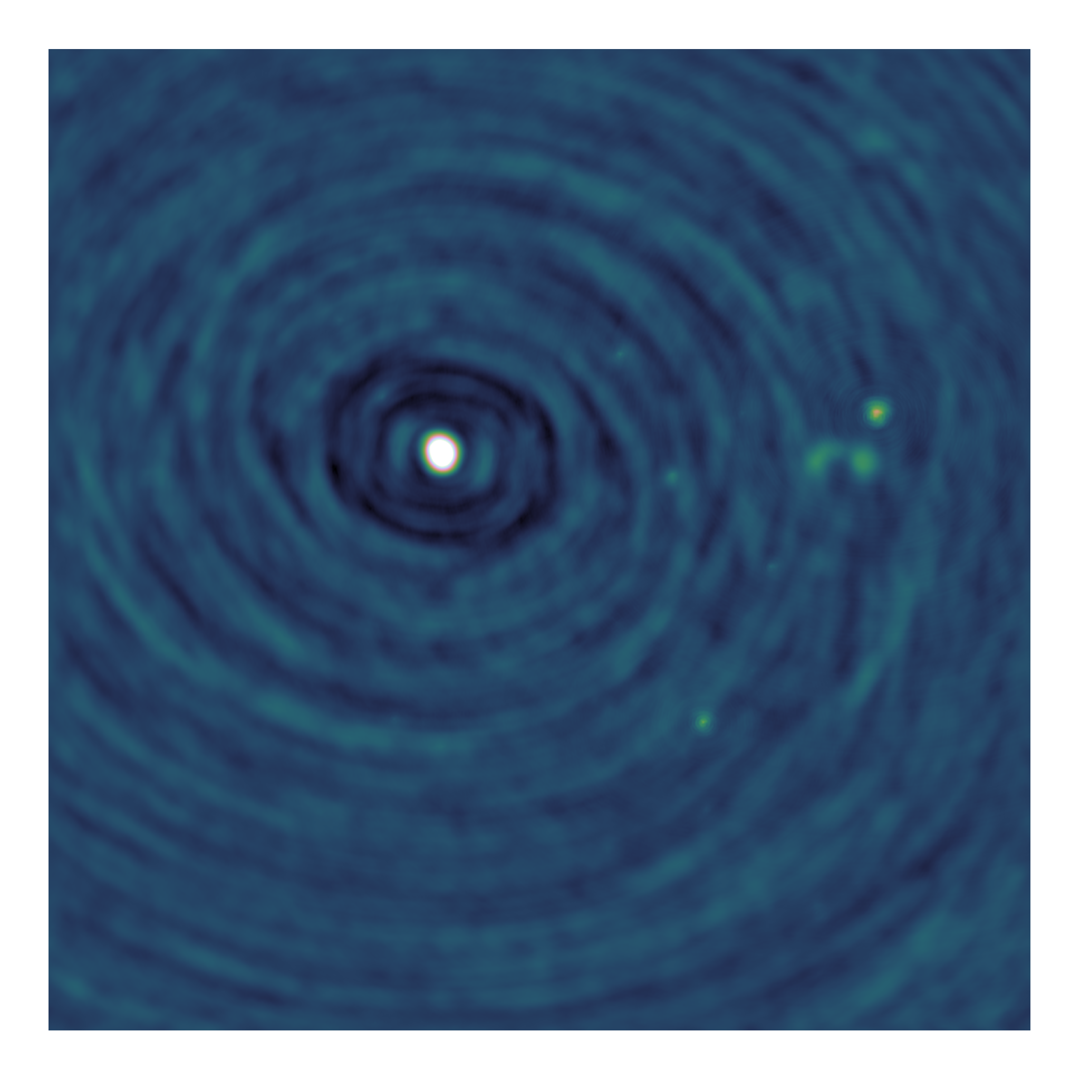
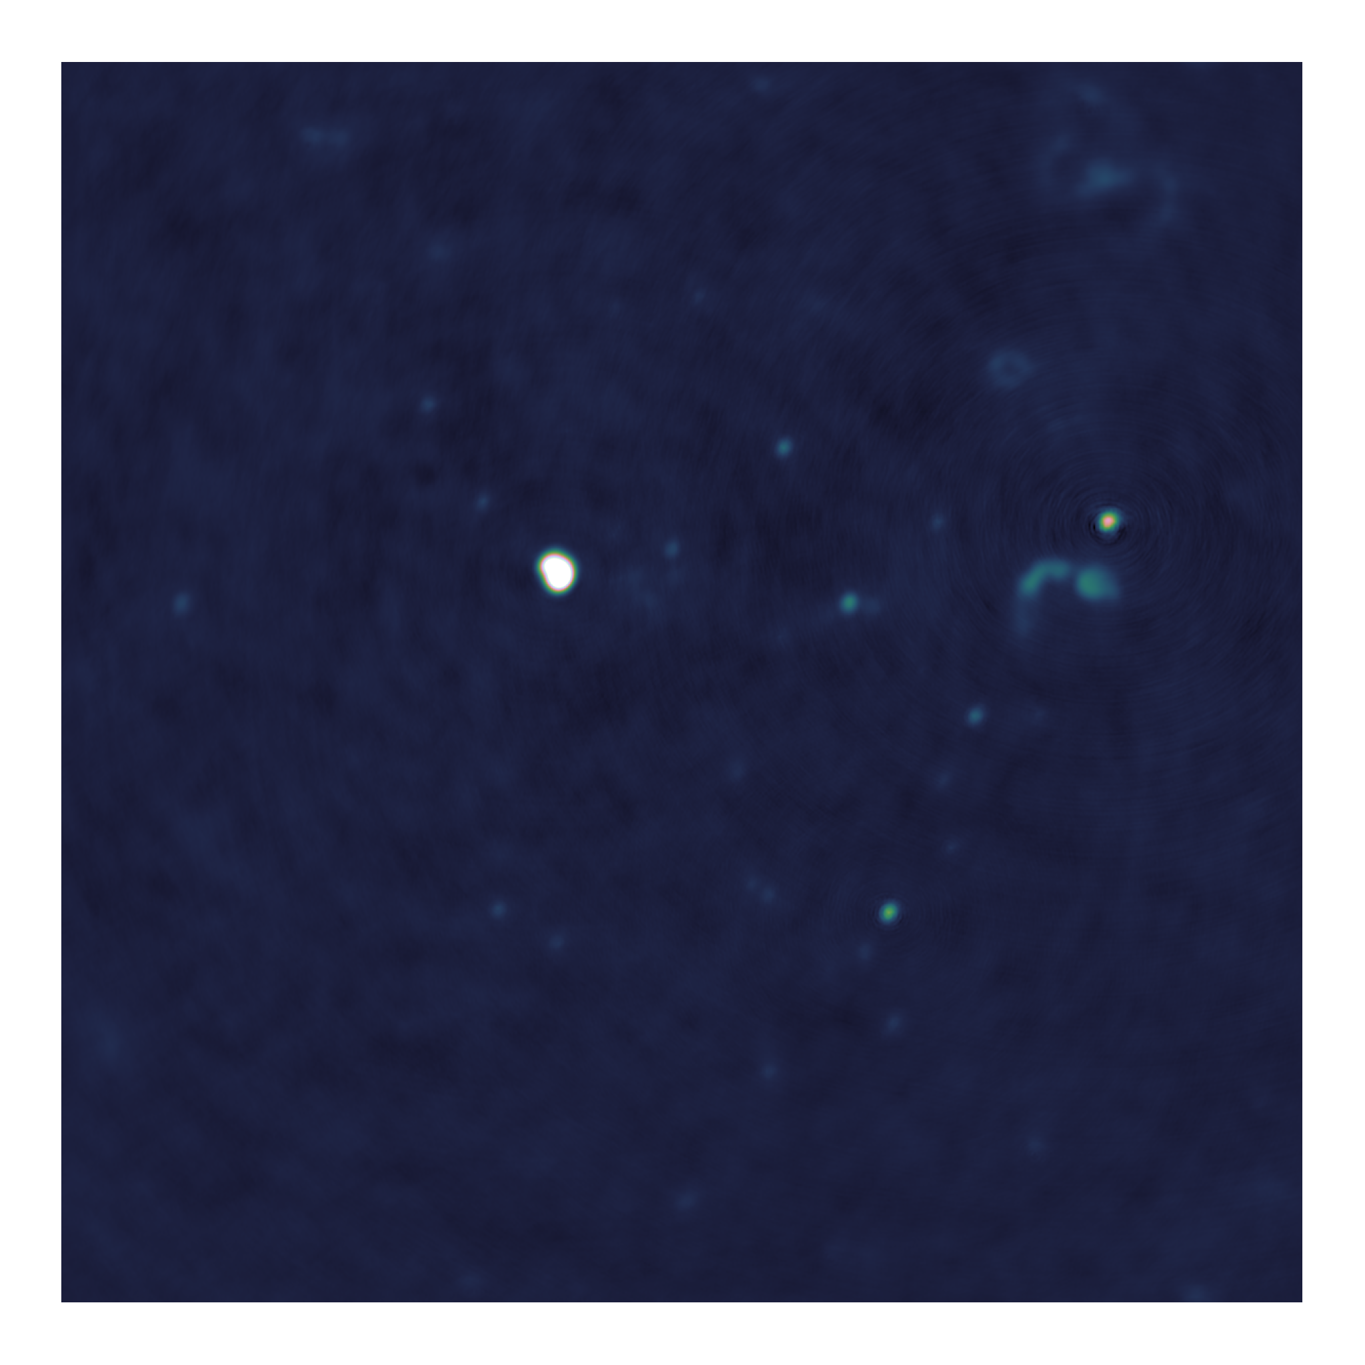
Towards distributed image reconstruction

Slide 2
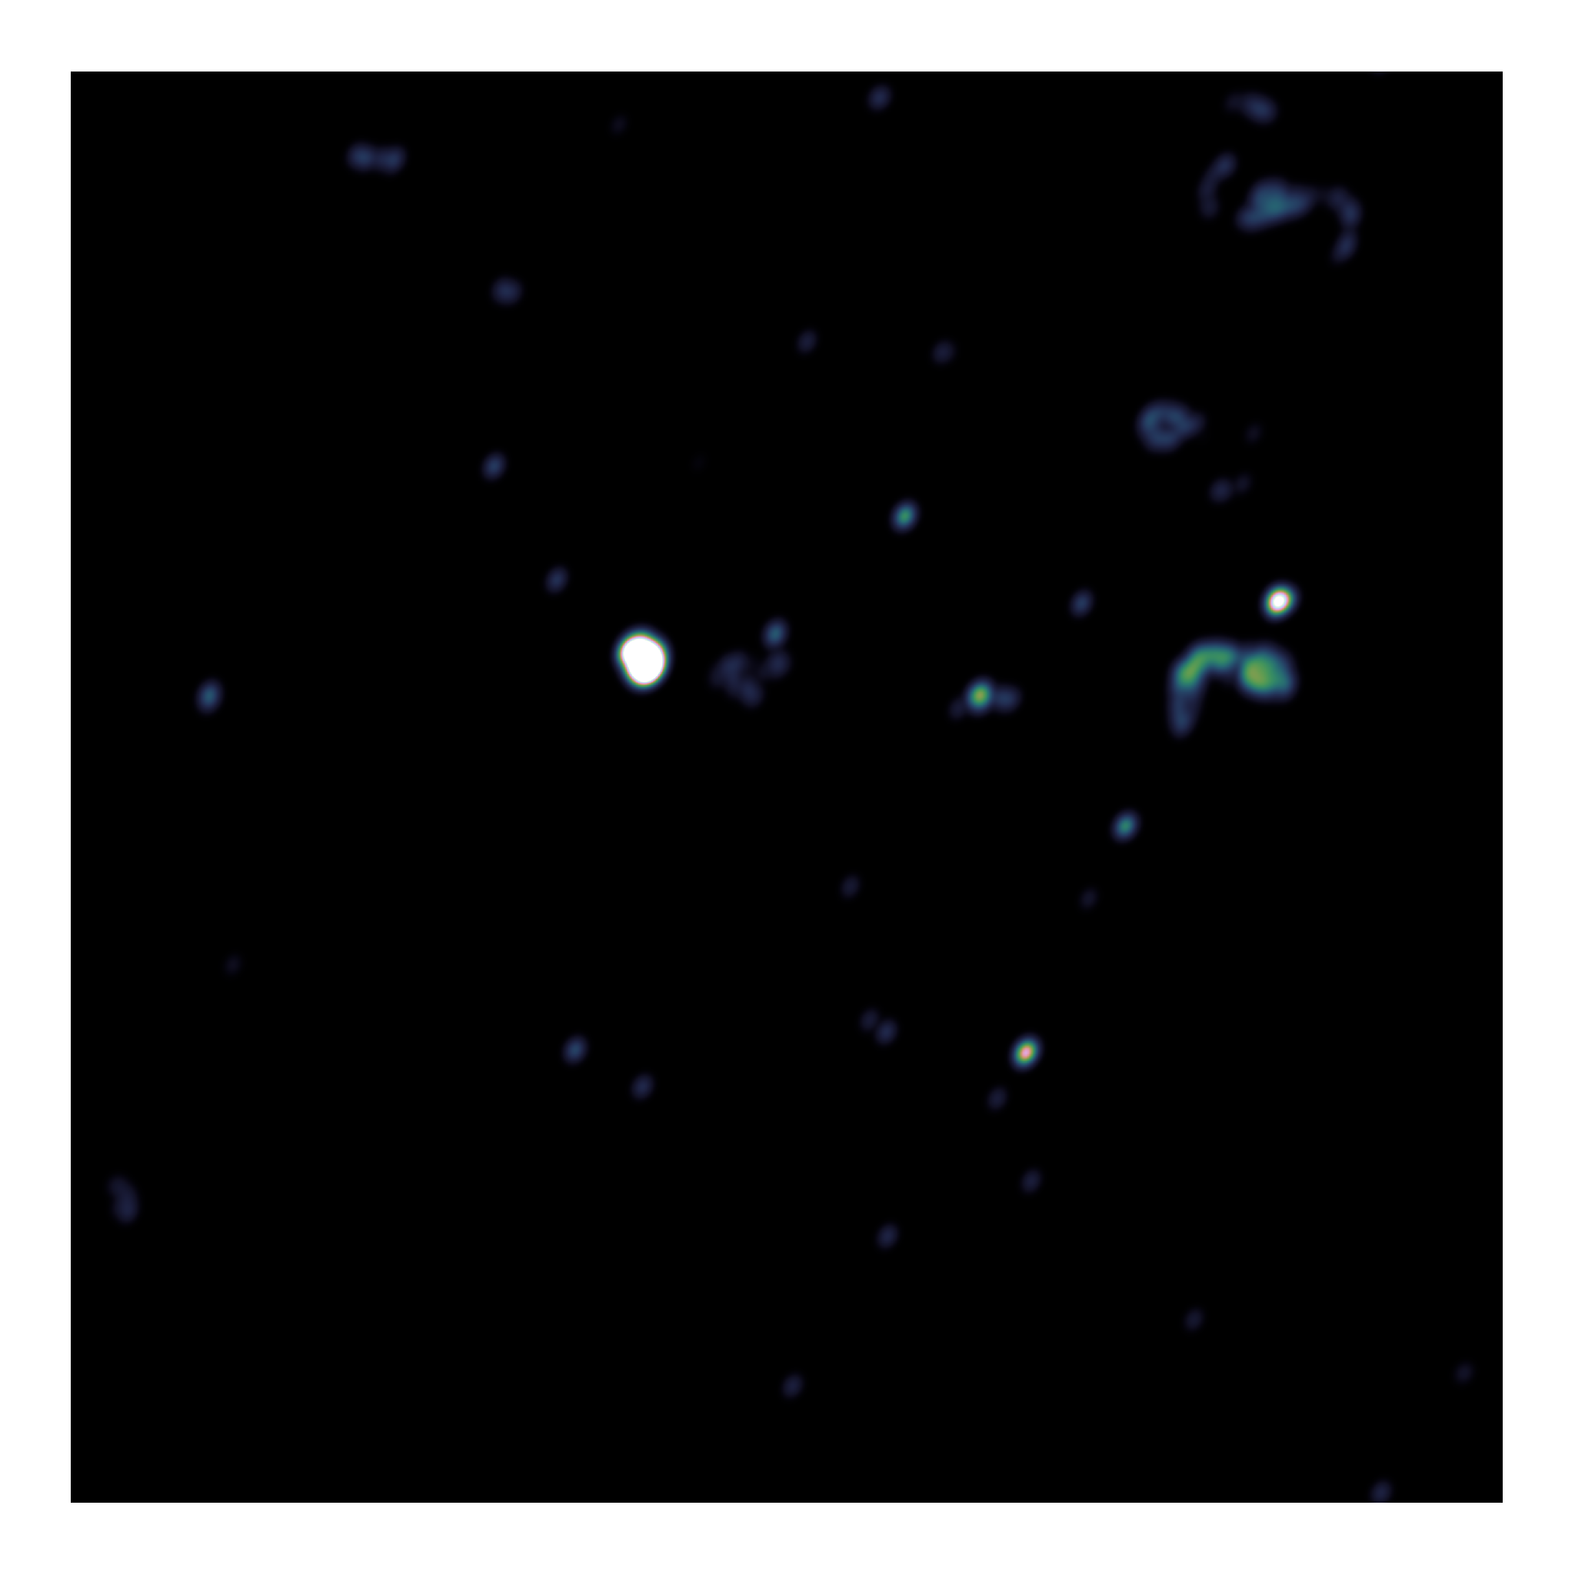
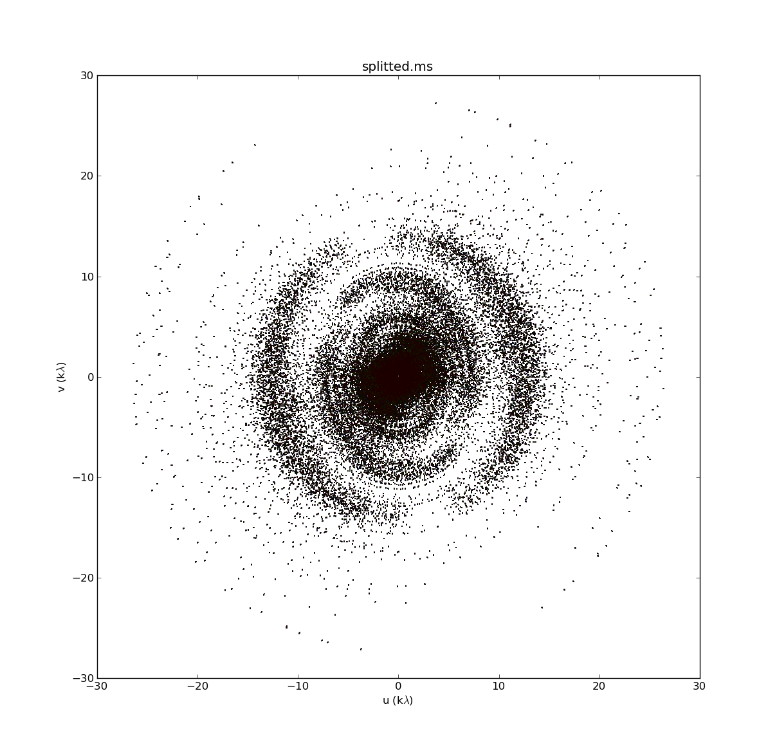
Image Reconstruction
Fourier Measurements
(Visibilities)
Dirty Image
Model Image
Fourier Transform
Deconvolution

Slide 3
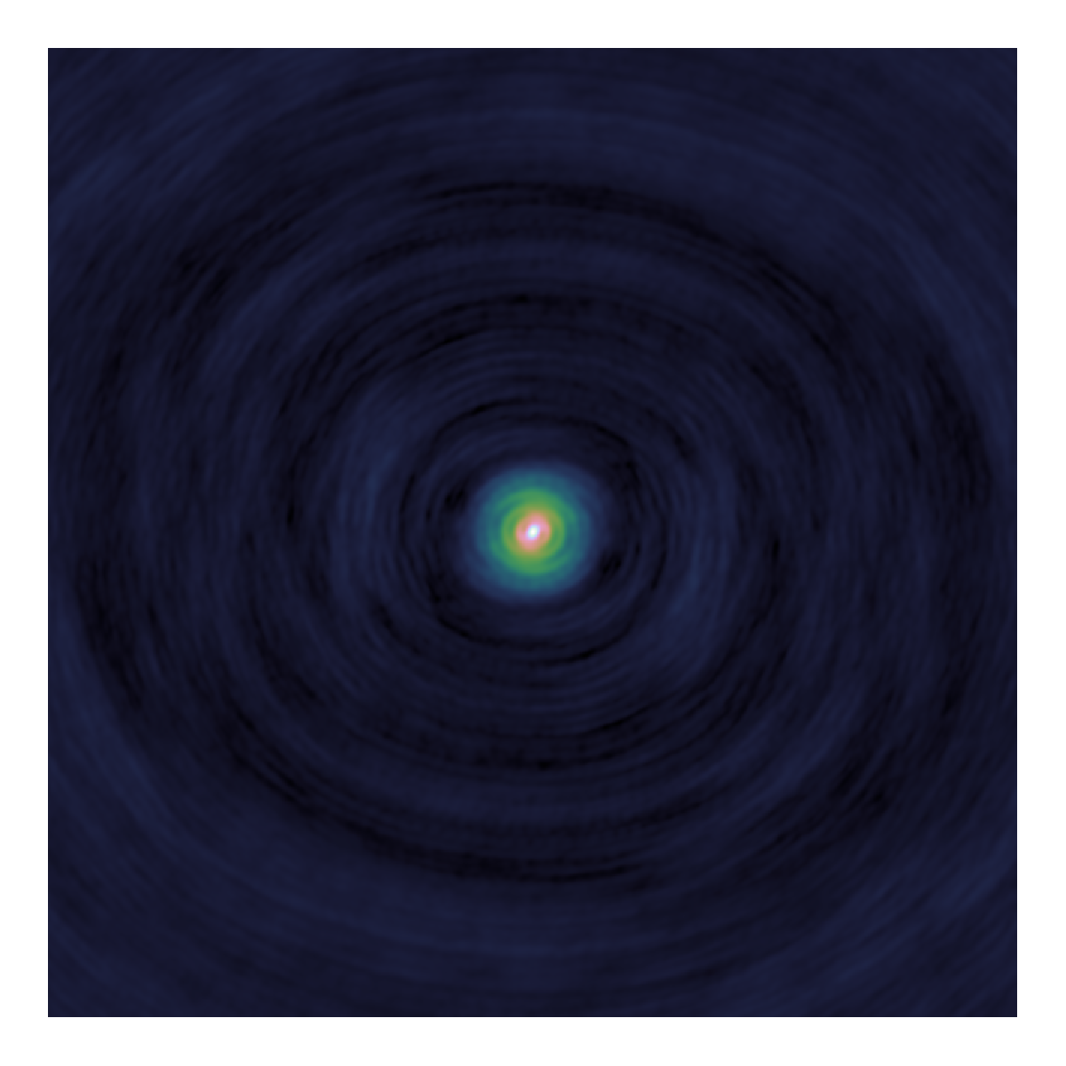
Deconvolution
Dirty
Image
Model
Image
PSF

Slide 4
Major/Minor Cycle
Fourier Transform
Deconvolution
Dirty
Image
Model
Visibilities
Residual
Visibilities
Model
Image
PSF
Fourier Transform

Slide 5
What do I show you?
Deconvolution algorithms
CLEAN
Serial Coordinate Descent
Parallel Coordinate Descent Algorithm + PSF Approximation

Slide 6
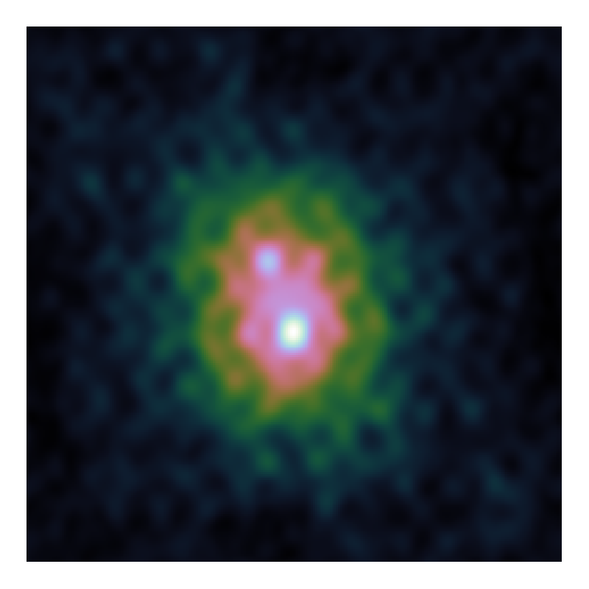
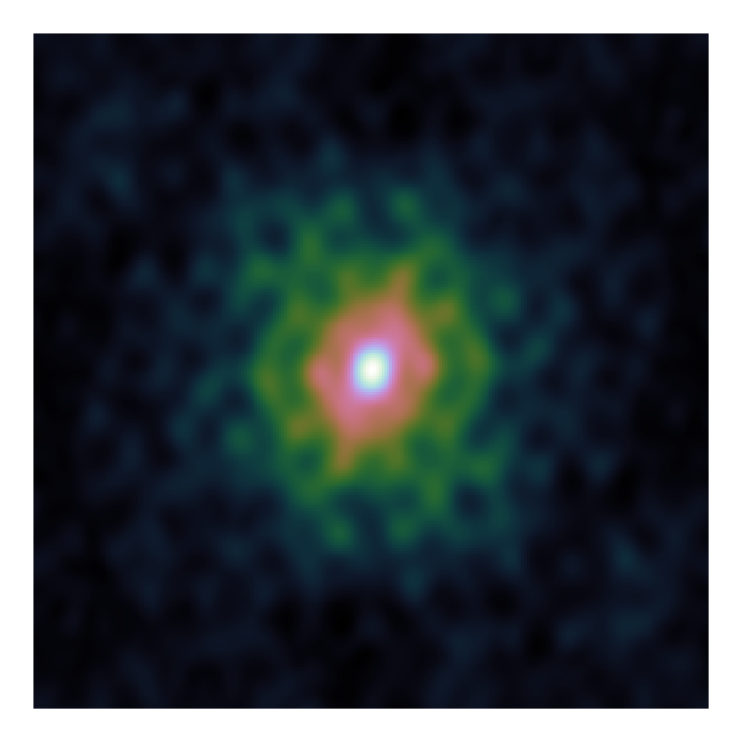
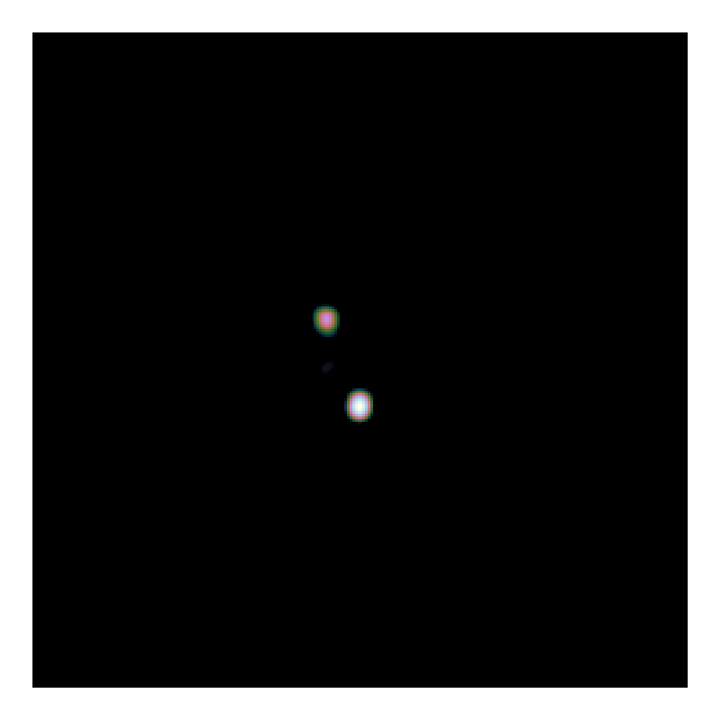
Deconvolution problem

Slide 7
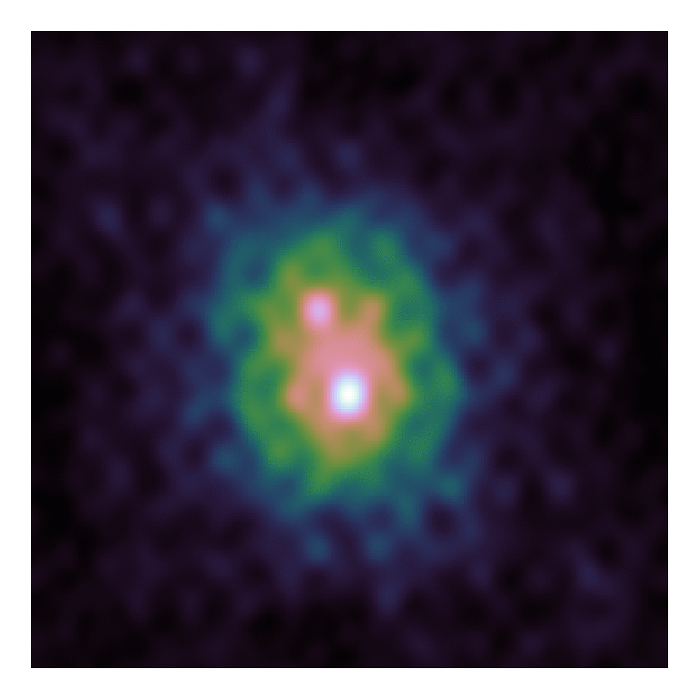

CLEAN
Dirty Image
Model Image

Slide 8
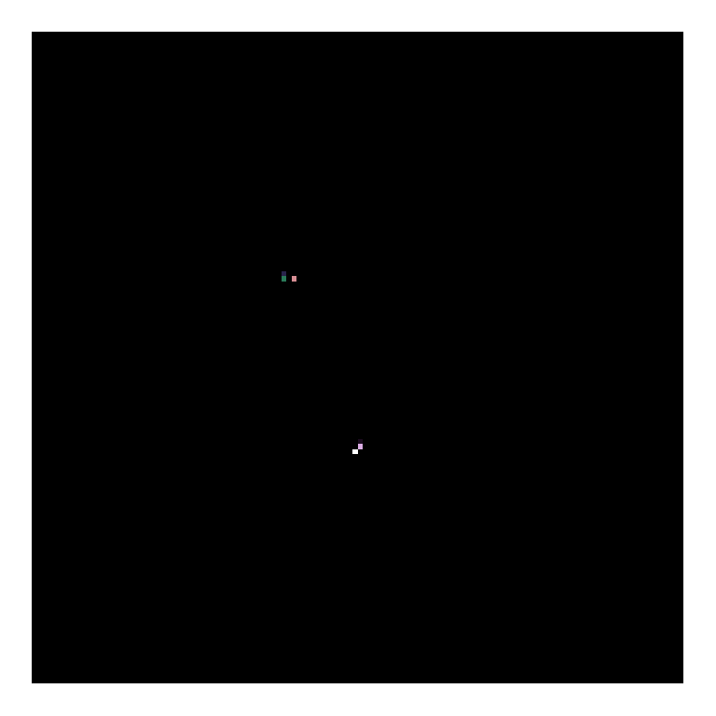
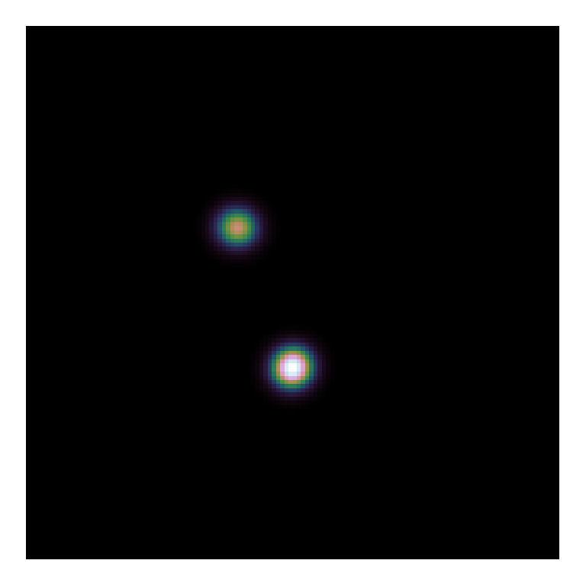
CLEAN
Model Image
Restored Image

Slide 9
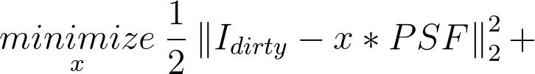
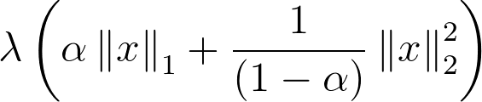
Serial Coordinate Descent
Deconvolution objective
Plausible model Image

Slide 10
Serial Coordinate Descent
Deconvolution objective
Plausible model Image
Image contains stars…
…But also
clouds of gas/dust

Slide 11
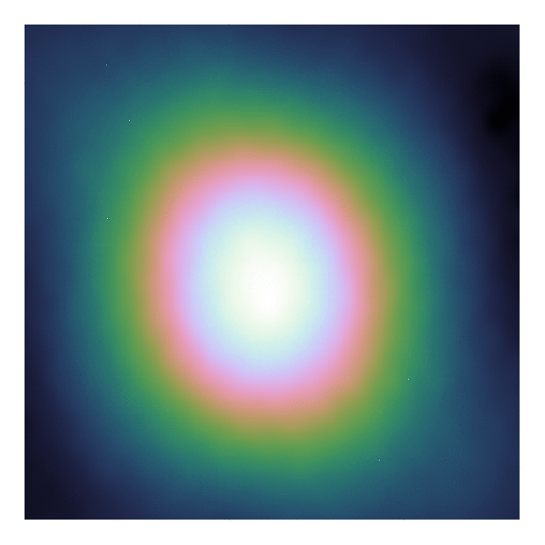

Serial Coordinate Descent
Gradient Map
Model Image

Slide 12
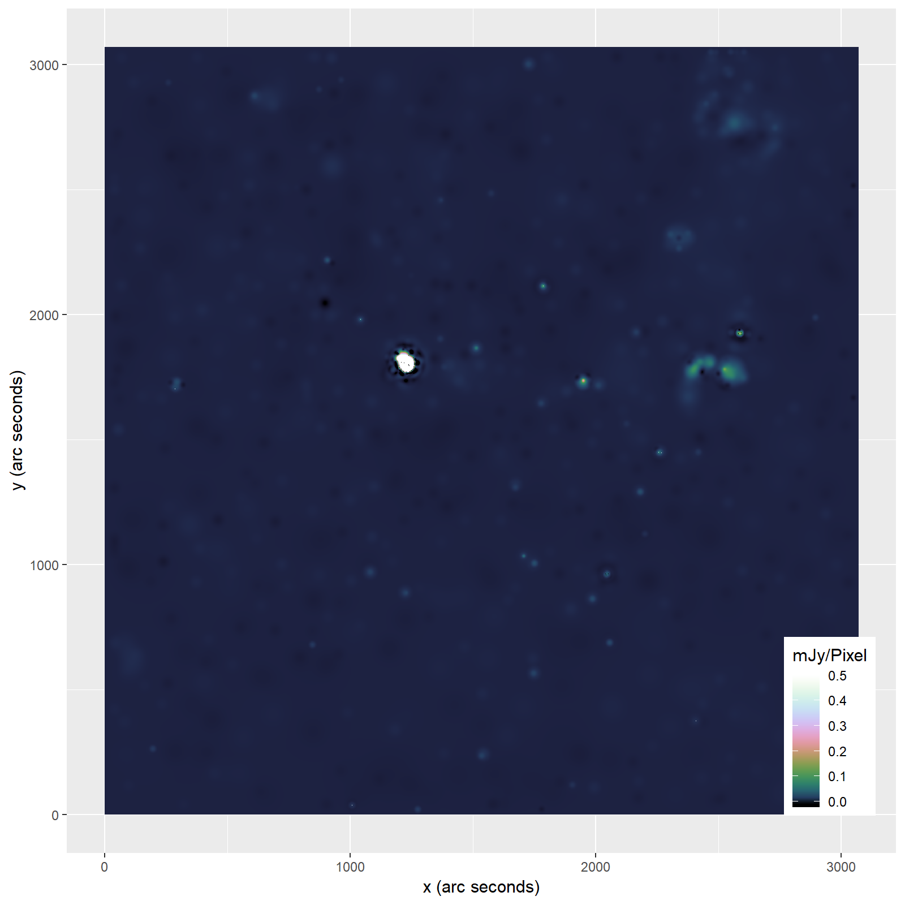

Slide 13
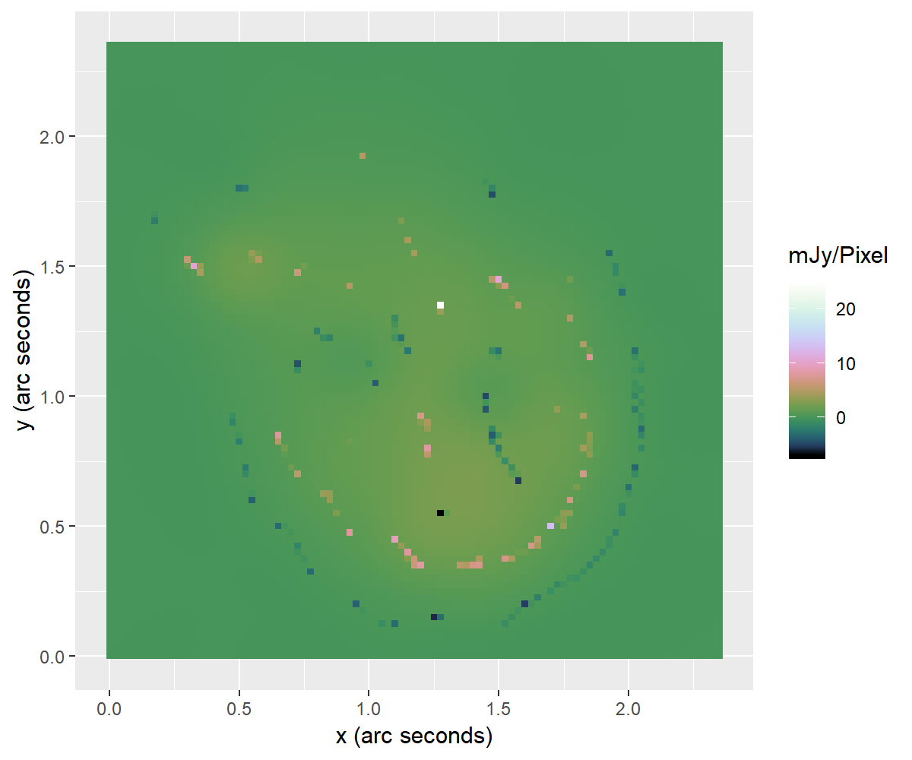
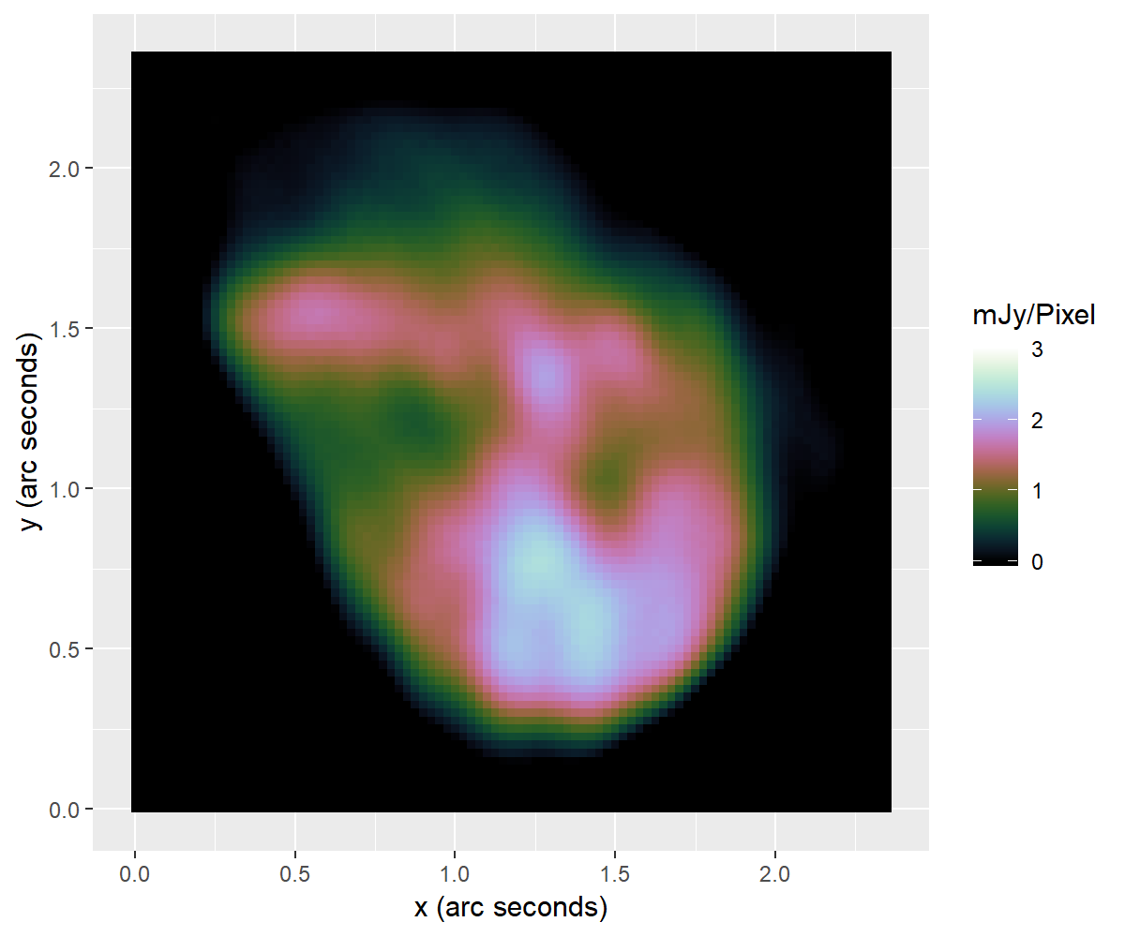
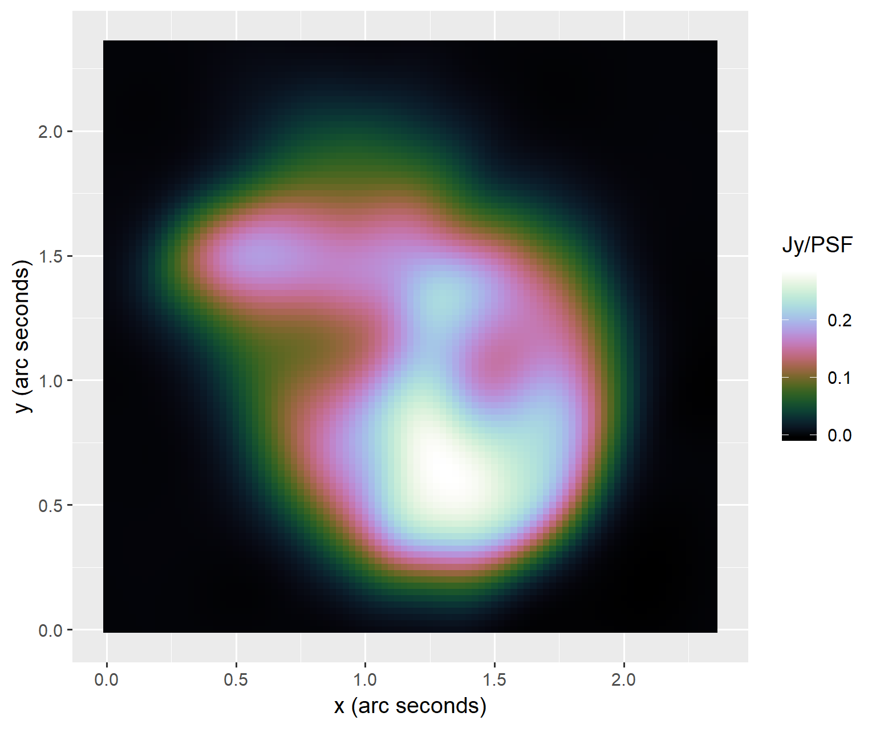
Plausible Super-Resolution
MS-CLEAN model
CD model
MS-CLEAN Briggs restored

Slide 14
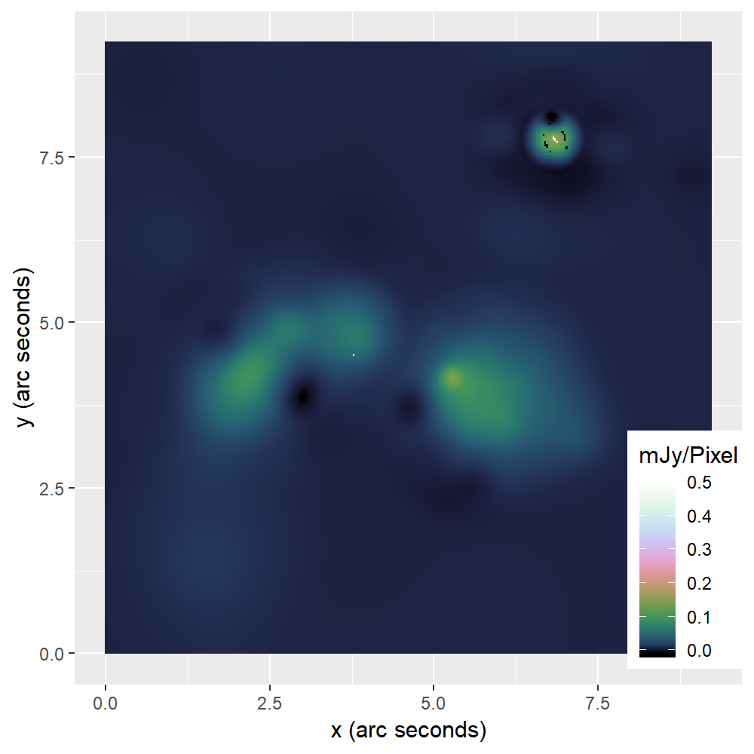
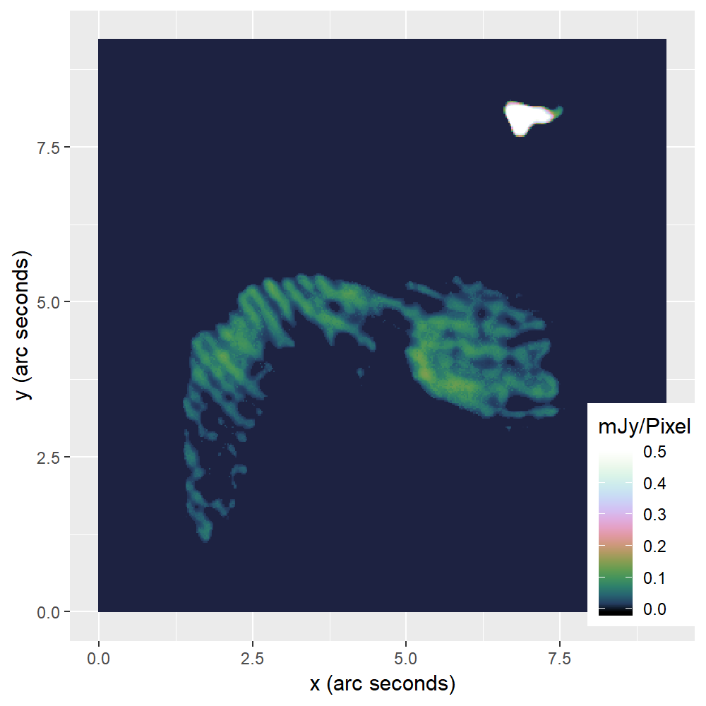
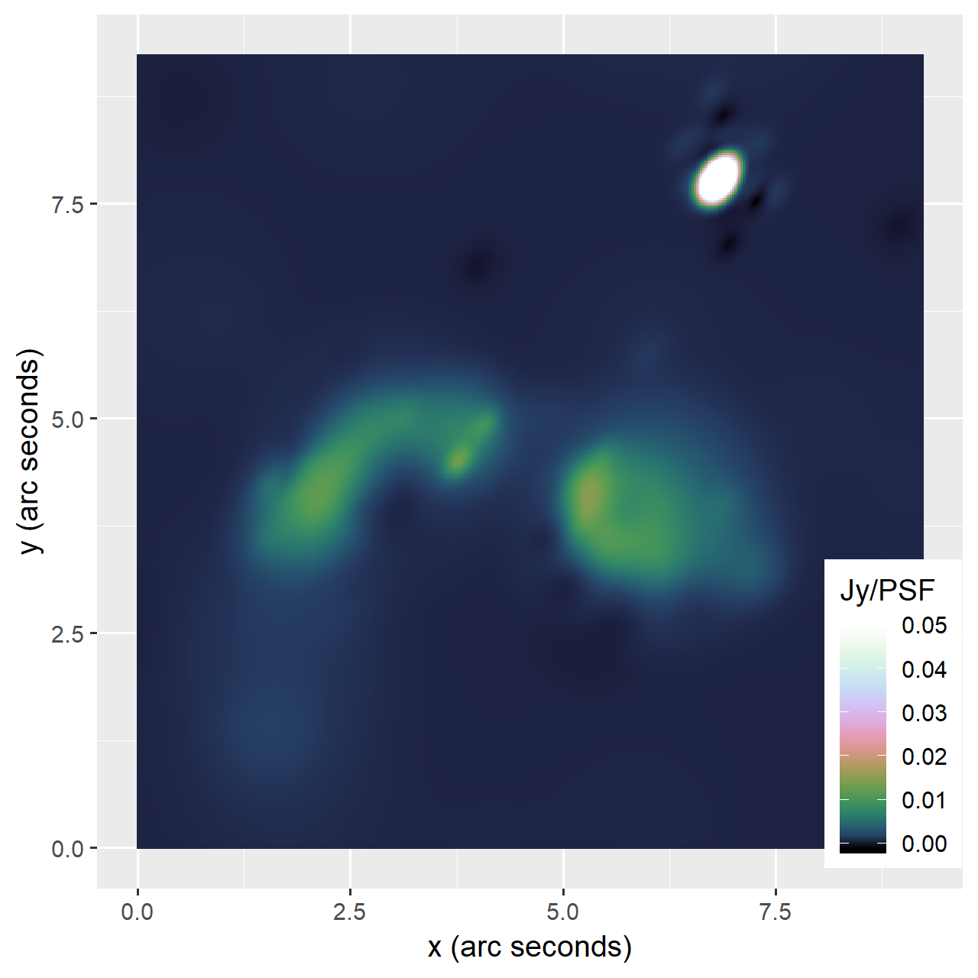
Calibration Errors
MS-CLEAN model
CD model
MS-CLEAN Briggs restored

Slide 15
Conclusion Reconstruction

Slide 16
Parallel updates

Slide 17
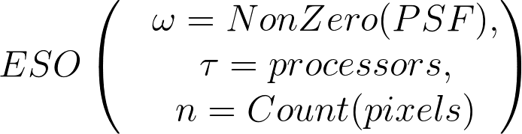
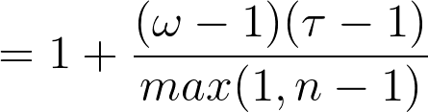
Estimated Separability Over-approximation (ESO)

Slide 18
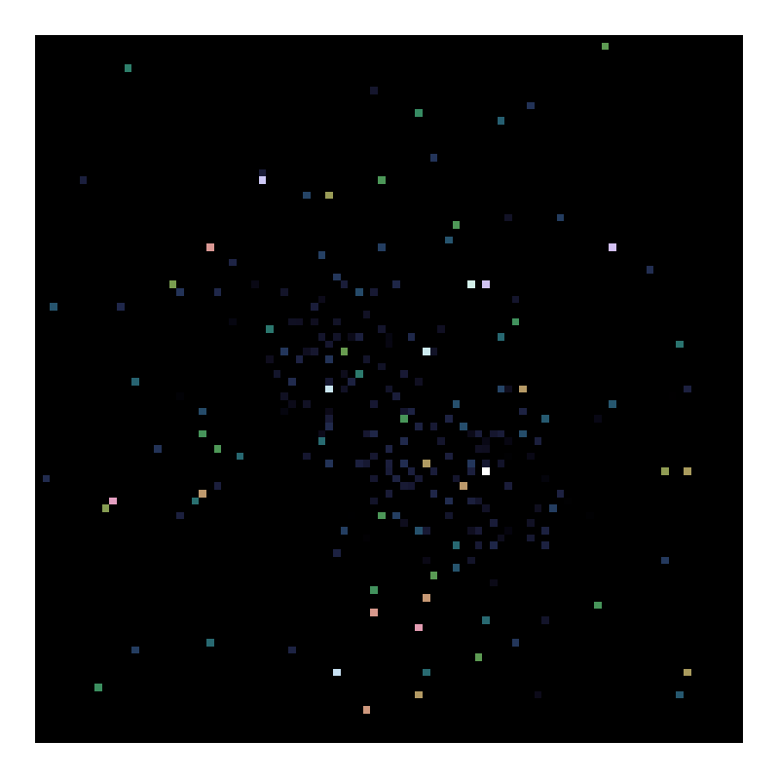
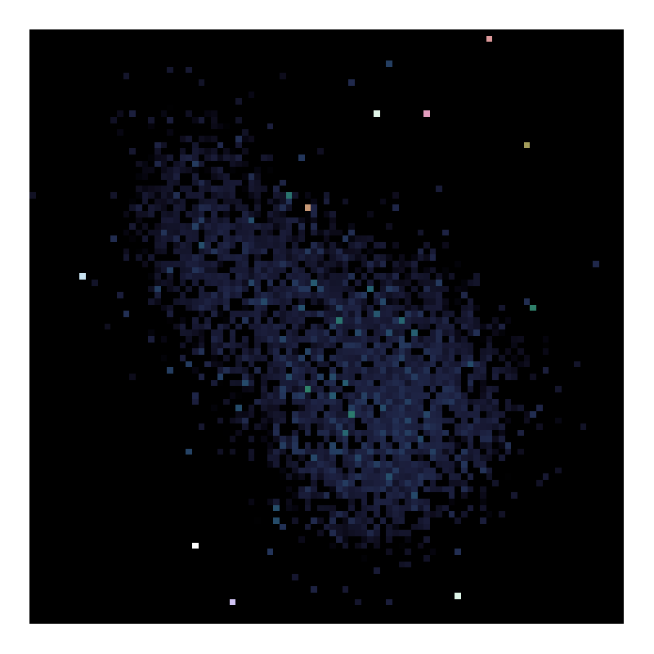
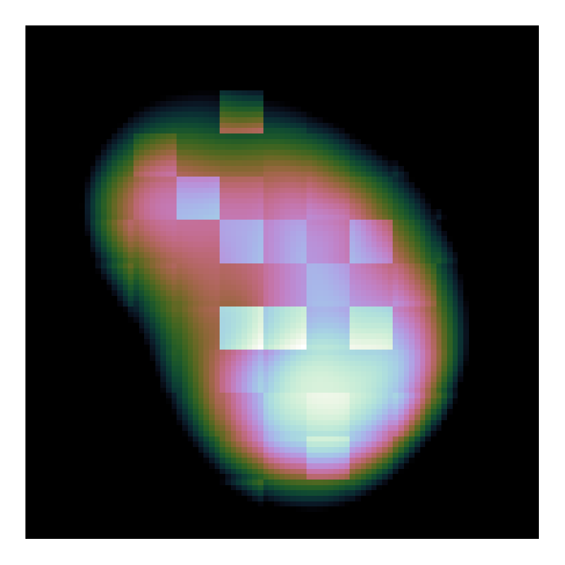
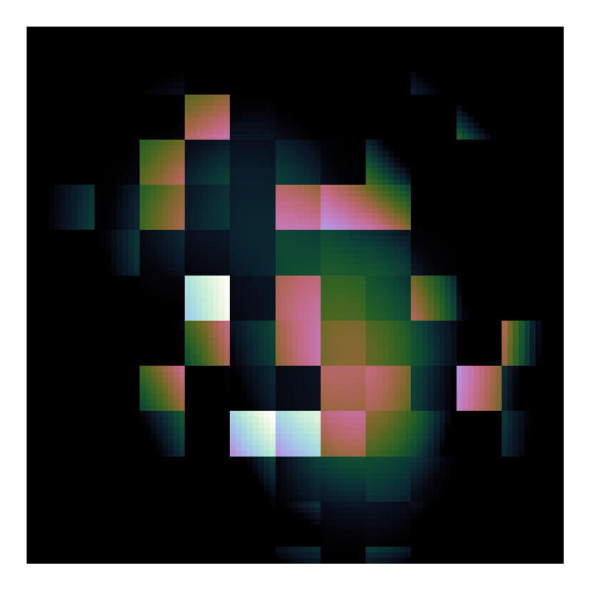
Random Selection Strategy and ESO
Model Image of
Random Block (8*8 pixels) Selection
Model image of
Random Pixel Selection

Slide 19
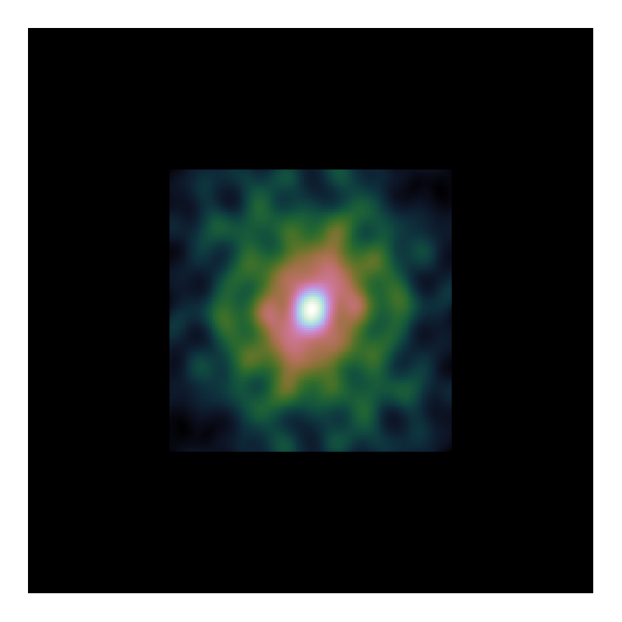
PSF Approximation

Slide 20
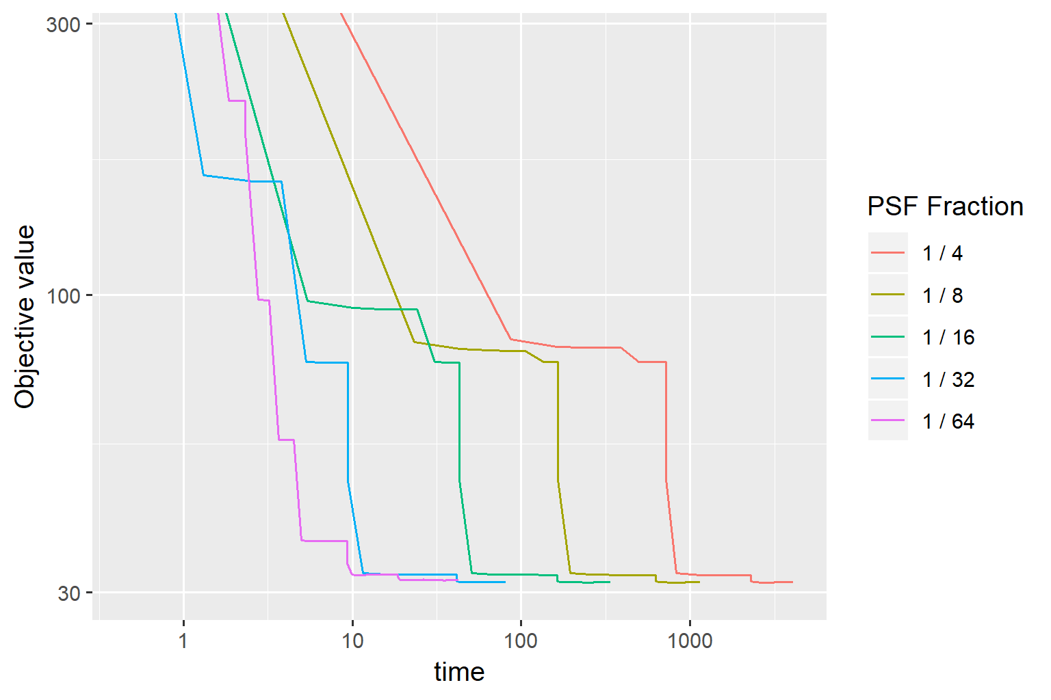
Speedup PCDM

Slide 21
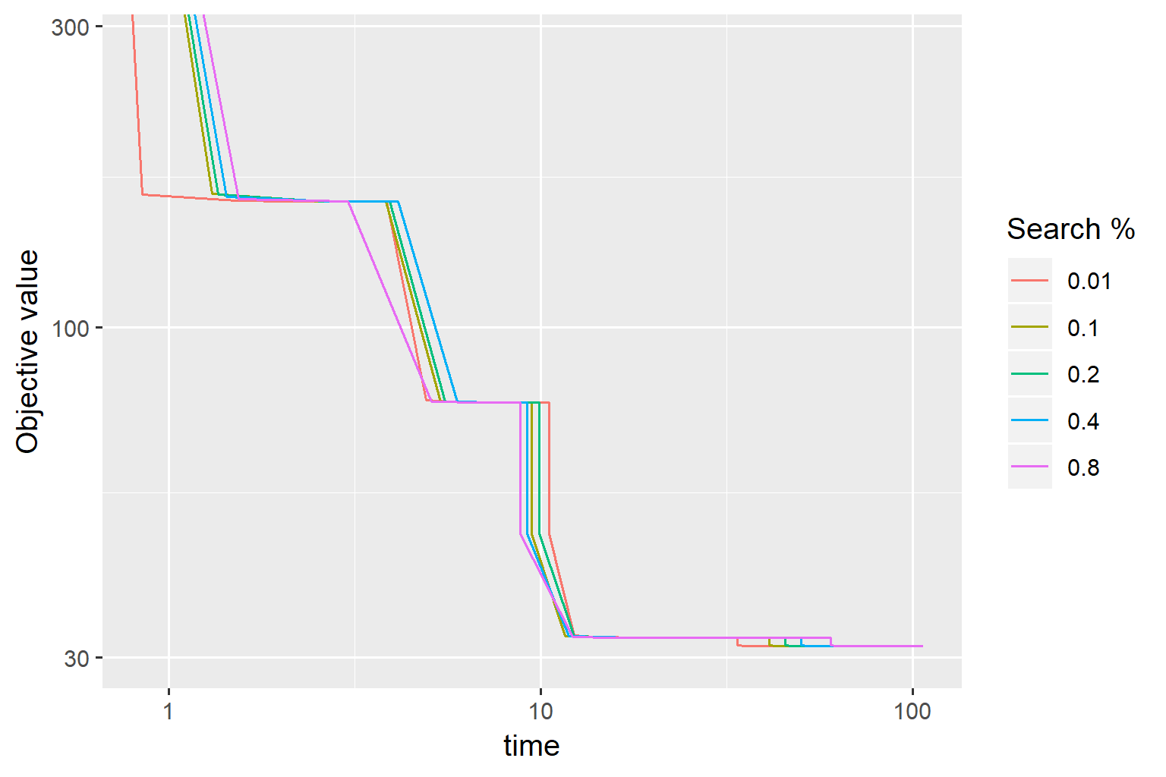

Slide 22
Speed comparison to CLEAN

Slide 23
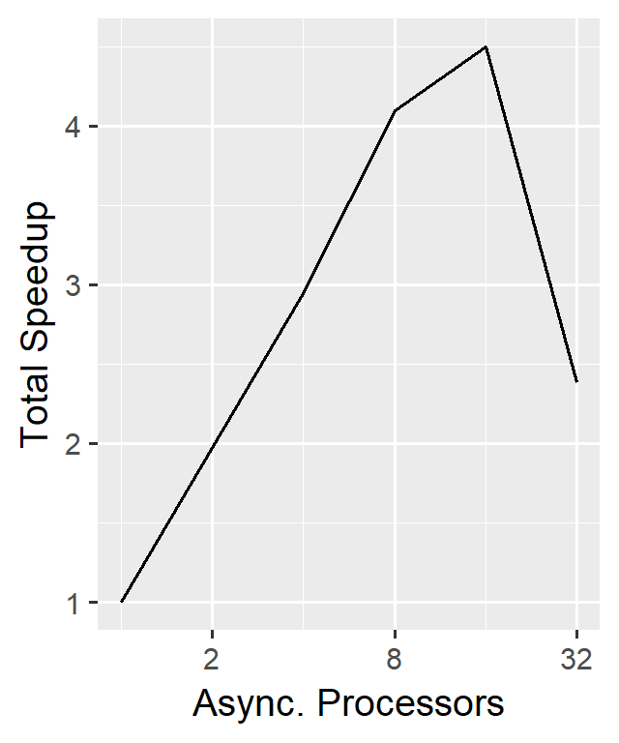
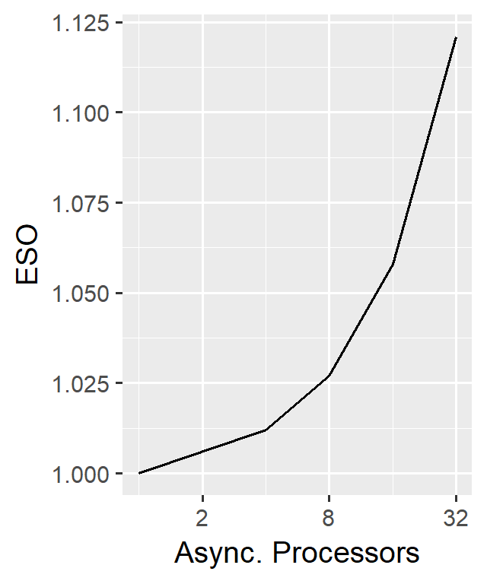
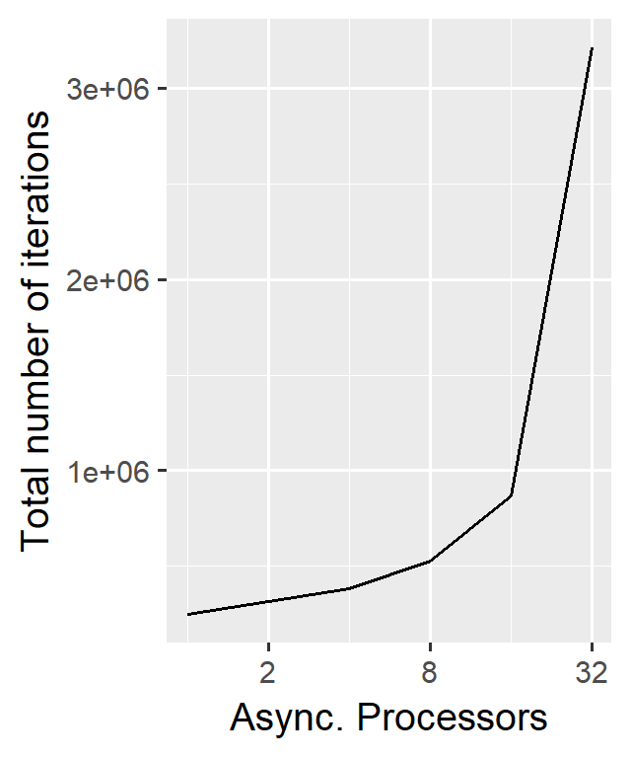
Scalability

Slide 24
Test
Table

Slide 25
Conclusion
Problem with facets
How much distribution
How useful is elasticnet

Slide 26
Conclusion 2
Fast algorithm. Possible to distribute

